Slide 1
CSE 405
I/O Interfacing
Osama Hosameldeen
Spring 2021
Lecture 6: Discrete Sampling & Analysis of Time-Varying Signals

Slide 2
Sampling and Recording
When perform a measurement … a transducer converts the measurand into an electrical signal … and this signal is “sampled” using a digital computer
We normally record a continuous signal y(t) by a set of samples y_{s}(t) at discrete intervals of time Δt.
y(t)
y_{S}(t)
t
t

Slide 3

Sampling Frequency
Δt
y_{S}(t)
t
The number of samples recorded each second is defined as the sampling frequency, f_{S}.

Slide 4
Resemble Sampling Data
Original signal
Sampled signal
If a signal is sampled and recorded relative rapidly, the sampled data will closely resemble the original signal.

Slide 5
Under Sampling of Test Data
Original signal
Sampled data
If we sampled too slowly, a recorded data will present a distortion from the original signal. Such distortion will introduce some measurement errors.

Slide 6
Sampling and Hold
Almost any analog to digital converter will have some form of voltage “hold” before sampling. A sampling and hold unit is used to hold each sample value until the next pulse occurs. The sampling and hold unit is necessary because the A/D converter requires a finite amount of time.
y(t)
y_{S}(t)
t
t

Slide 7
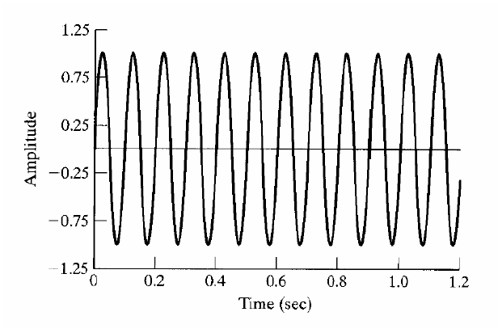
A 10 Hz Sine Wave Signal

Slide 8
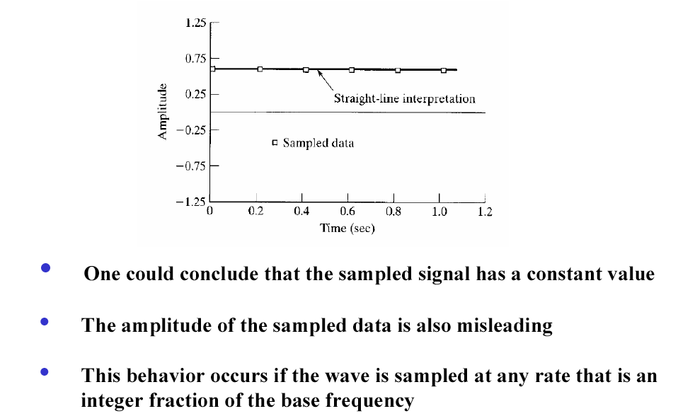
Sampling Rate ~ 5 Hz

Slide 9
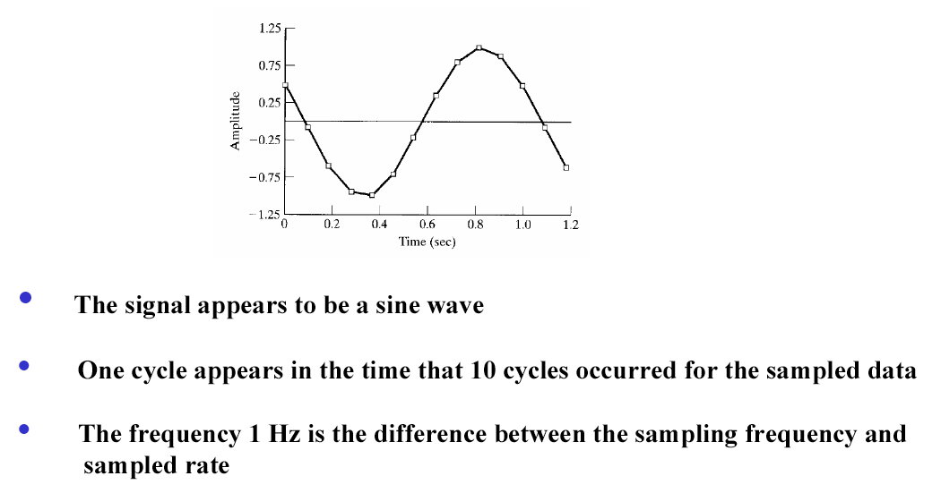
Sampling Rate ~ 11 Hz

Slide 10
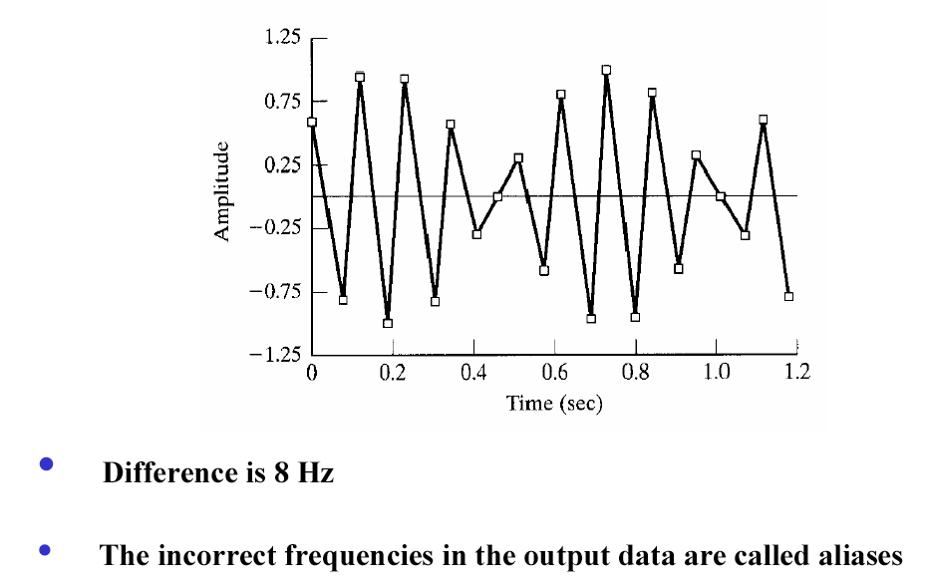
Sampling Rate ~ 18 Hz
At a sampling frequency of 18 Hz, the reconstructed sine wave appears to be of 8 Hz sine wave. That is, the frequency of the sine wave reconstructed from the sampled data is still different from that of the original signal.
These incorrect frequencies that appear in the output data range are known as alias frequencies or aliases. The alias frequencies are false frequencies that appear in the output data, that are simply artifacts of the sampling process, and that do not (in any matter) occur in the original data.

Slide 11
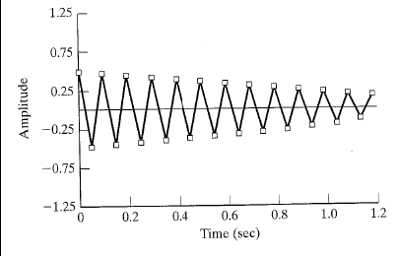
Sampling Rate ~ 20.1 Hz
• Now, consider the reconstruction of the original signal based on the sampling rate of 20.1 Hz.
• The above figure shows the signal reconstructed from the data sampled at a frequency of 20.1 Hz. The reconstructed wave has a frequency of 10 Hz, which is the same frequency as the original signal. However, the amplitude of the reconstructed wave is lower than the original one.

Slide 12

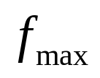

Nyquist Sampling Theorem
A continuous signal can be represented by, and reconstituted from, a set of sample values providing that the number of samples per second is at least twice the highest frequency presented in the signal.
is the signal frequency (or the maximum signal frequency if there is more than one frequency in the signal)
is the sampling rate

Slide 13
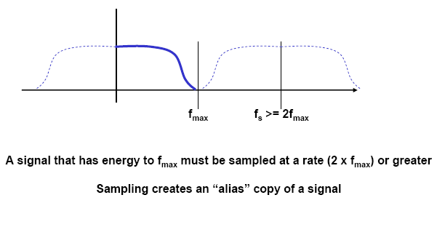
Nyquist Sampling Theorem

Slide 14
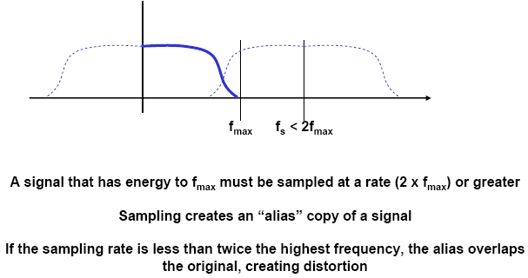
Nyquist Sampling Theorem

Slide 15
Discussion Question
Nyquist sampling theorem tells us that the sampling frequency should be at least twice the highest frequency presented in the signal to be able to resemble the pattern of the original signal.
Use your common sense knowledge, to determine what is the proper sampling frequency if you are requested to design a vibration monitoring system for a passenger car. Assume that the natural frequency of the car system is 10 Hz, the driving stimulated vibration on driver’s seat is 120 Hz, and the measurement system natural frequency is 10 kHz.
What is the sampling frequency you will select?

Slide 16
Nyquist Frequency and Aliasing (1)
High frequency signal to be sampled by a low sampling rate may cause to “fold” the sampled data into a false lower frequency signal. This phenomena is known as aliasing.

Slide 17
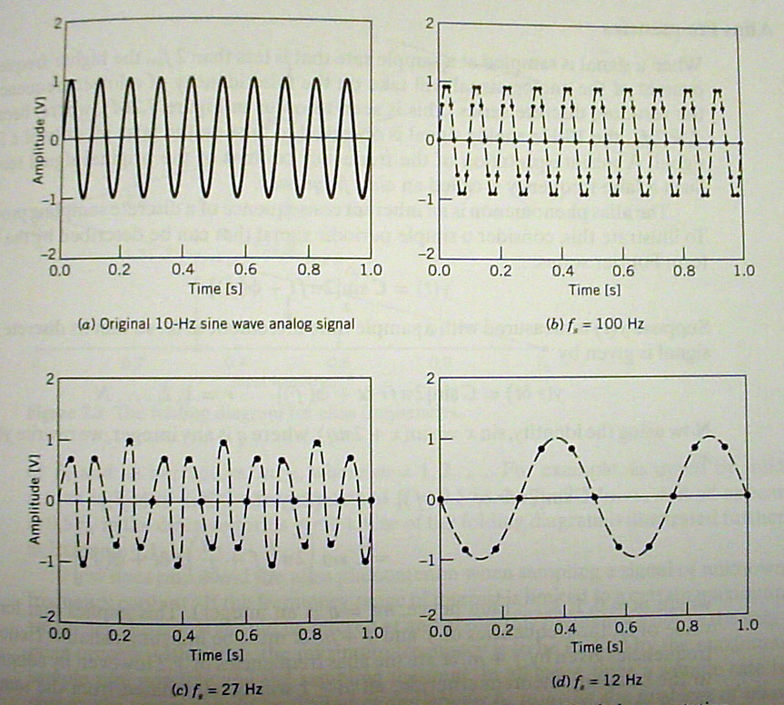
Aliasing Example

Slide 18
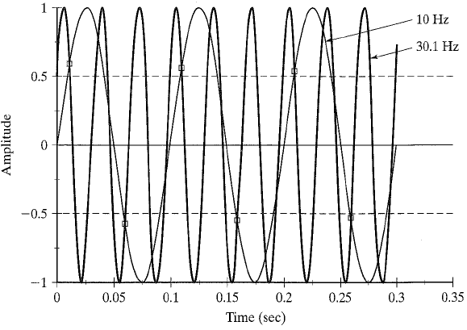
Higher Frequency Aliases

Slide 19
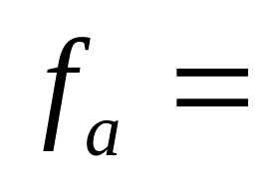
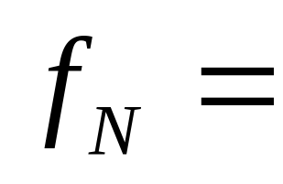
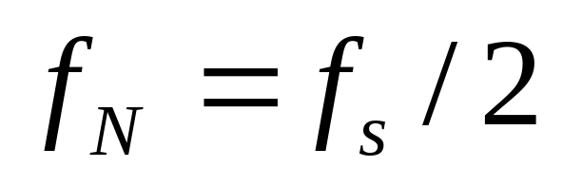
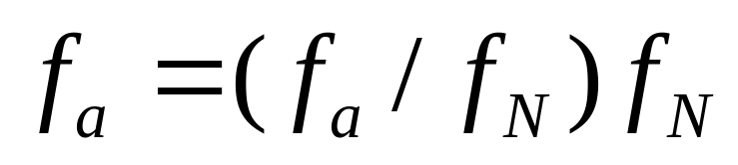
Aliasing Formulas
Alias frequency
Folding frequency (Nyquist frequency)

Slide 20
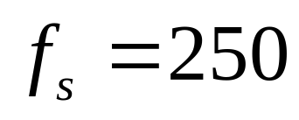
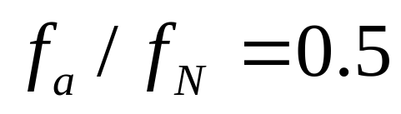
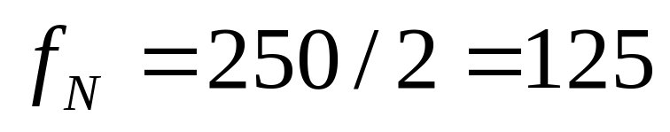
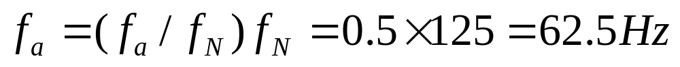
Question
Given that sampling frequency equals 250Hz and the ratio of folding frequency to alias frequency equals 0.5, find the alias frequency.
Solution:

Slide 21
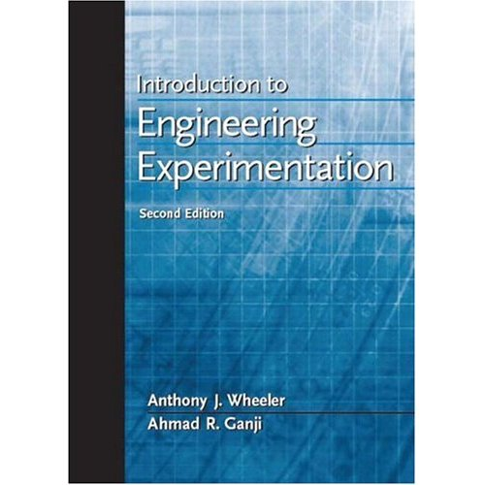
Reference
Introduction to Engineering Experimentation by A.J. Wheeler and A.R. Ganji (2 nd edition), Pearson Prentice Hall, 2004.
https://users.encs.concordia.ca/home/c/cheung/Document%20save/MECH373-MEASUREMENTS/LECTURE/

